Slide 1

Web Development & Design Foundations with HTML5
Tenth Edition
Chapter 9
Forms
Copyright © 2021, 2019, 2017 Pearson Education, Inc. All Rights Reserved

Slide 2
Learning Outcomes (1 of 2)
In this chapter, you will learn how to ...
Describe common uses of forms on web pages
Create forms on web pages using the form, input, textarea, and select elements
Create forms that provide additional accessibility features using the accesskey and tabindex attributes
Associate form controls and groups using the label, fieldset, and legend elements
Create custom image buttons and use the button element

Slide 3
Learning Outcomes (2 of 2)
Use CSS float to style a form
Use CSS Grid Layout to style a form
Configure HTML5 form controls including the email, URL, datalist, range, spinner, calendar date-picker, and color controls
Describe the features and common uses of server-side processing
Invoke server-side processing to handle form data
Find free server-side processing resources on the Web

Slide 4
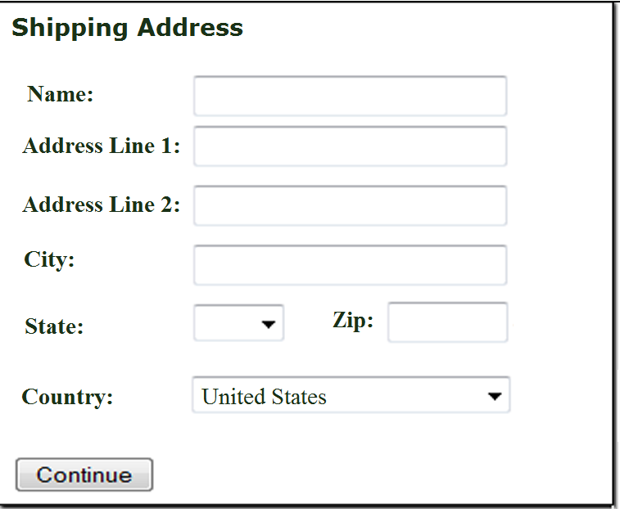
Overview of Forms (1 of 2)
Forms are used all over the Web to
Accept information
Provide interactivity
Types of forms:
Search form, Order form, Newsletter sign-up form, Survey form, Add to Cart form, and so on…
Figure 9.1 This form accepts shipping information

Slide 5
Overview of Forms (2 of 2)
Form
An HTML element that contains and organizes
form controls such as text boxes, check boxes, and buttons
that can accept information from website visitors.
Figure 9.1 This form accepts shipping information

Slide 6
Two Components of Using Forms
The HTML form
the web page user interface
and
The server-side processing
Server-side processing works with the form data and sends e-mail, writes to a text file, updates a database, or performs some other type of processing on the server.

Slide 7
HTML Using Forms (1 of 2)
<form>
Contains the form elements on a web page
Container tag
<input>
Configures a variety of form elements including text boxes, radio buttons, check boxes, and buttons
Stand alone tag

Slide 8
HTML Using Forms (2 of 2)
<textarea>
Configures a scrolling text box
Container tag
<select>
Configures a select box (drop down list)
Container tag
<option>
Configures an option in the select box
Container tag

Slide 9
Sample Form HTML (1 of 2)
<form>
E-mail: <input type="text" name ="email" id="email" required><br> <input type="submit"> <input type="reset">
</form>

Slide 10
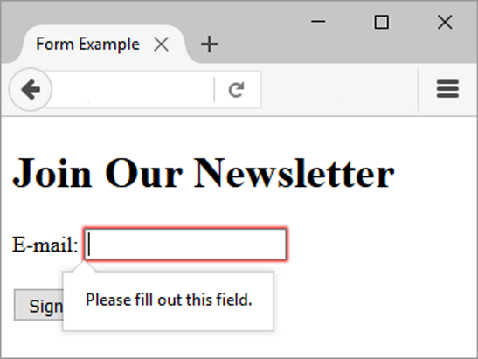
Sample Form HTML (2 of 2)
Figure 9.3 The browser displayed an error message

Slide 11
HTML form element
The form element attributes:
action
Specifies the server-side program or script that will process your form data
method
get – default value, form data passed in URL
post – more secure, form data passed in HTTP Entity Body
name
Identifies the form
id
Identifies the form

Slide 12
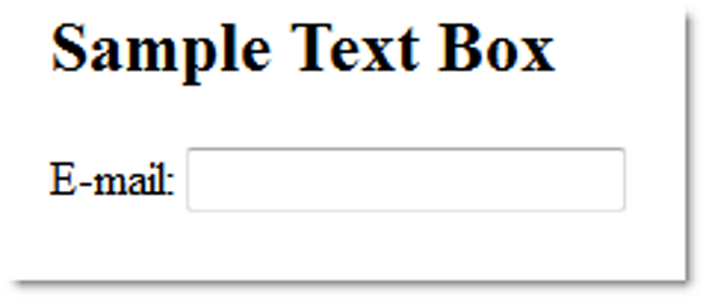
Input Text box
<input>
Accepts text information
Attributes:
type="text"
name
id
size
maxlength
value
Figure 9.2 The <input> tag with type="text" configures this form element

Slide 13
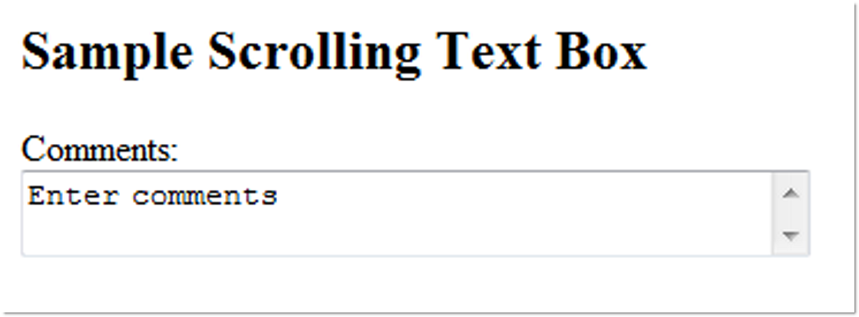
textarea Scrolling Text Box
<textarea> </textarea>
Configures a scrolling text box
Attributes:
name
id
cols
rows
Figure 9.9 Scrolling text box

Slide 14
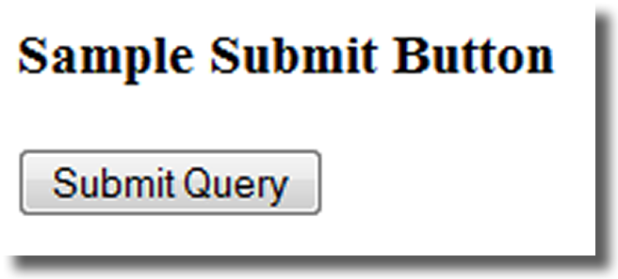
input Submit Button
<input>
Submits the form information
When clicked:
Triggers the action method on the <form> tag
Sends the form data (the name=value pair for each form element) to the web server.
Attributes:
type="submit"
name
id
value

Slide 15
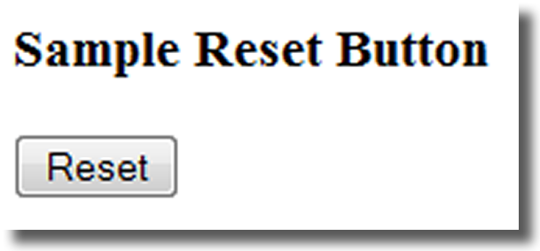
input Reset Button
<input>
Resets the form fields to their initial values
Attributes:
type="reset"
name
id
value

Slide 16
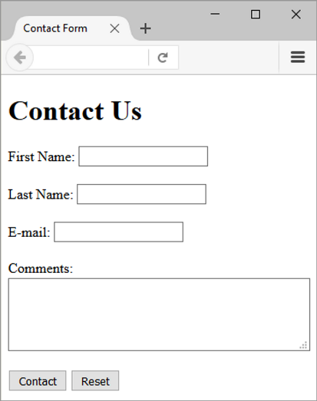
Hands-On Practice
Figure 9.10 A typical contact form

Slide 17
input File Upload Control (1 of 2)
<input>
Accepts a file upload when the form is submitted
Requires the form element to be configured with method="post", enctype="multipart/form-data“, and the action attriubute.

Slide 18

input File Upload Control (2 of 2)
Attributes:
type="file"
name
id
accepts
capture
multiple

Slide 19
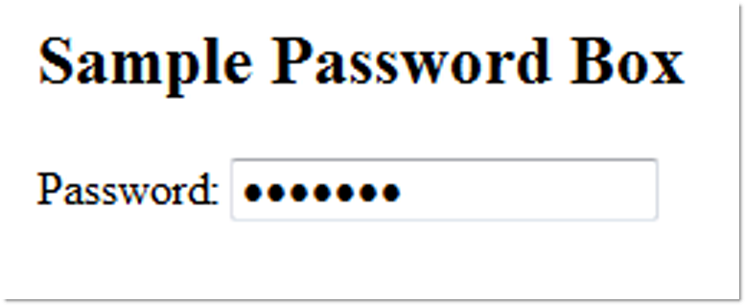
input Password box
<input>
Accepts text information that needs to be hidden as it is entered
Attributes:
type="password"
name
id
size
maxlength
value
Figure 9.8 The characters secret9 were
typed, but the browser does not display
them. (Note: Your browser may use a
different symbol, such as a stylized circle,to hide the characters.)

Slide 20
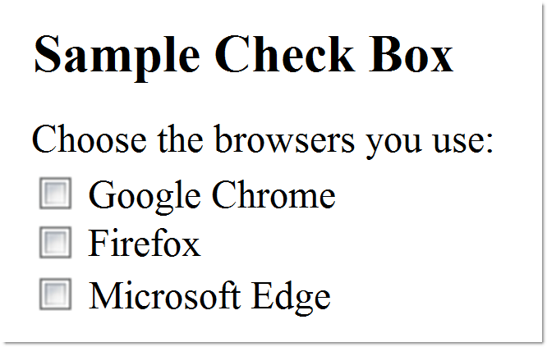
input Check box
<input>
Allows the user to select one or more of a group of predetermined items
Attributes:
type="checkbox"
name
id
checked
value
Figure 9.6 Sample check box

Slide 21
input Radio Button (1 of 2)
<input>
Allows the user to select exactly one from a group of predetermined items
Each radio button in a group is given the same name and a unique value

Slide 22
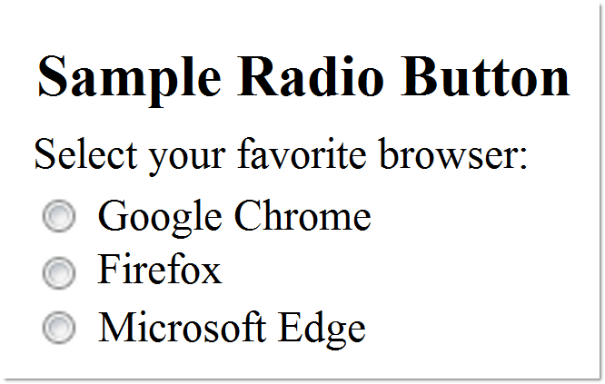
input Radio Button (2 of 2)
Attributes:
type="radio"
name
id
checked
value
Figure 9.7 Use radio buttons when only one choice is an appropriate response

Slide 23
input Hidden form data
<input>
This form control is not displayed on the web page.
Hidden form fields
Can be accessed by both client-side and server-side scripting
Sometimes used to contain information needed as the visitor moves from page to page.
Attributes:
type="hidden"
name
id
value

Slide 24
Select List (1 of 2)
<select></select>
Configures a select list (along with option elements)
Also known as: Select Box, Drop-Down List, Drop-Down Box, and Option Box.
Allows the user to select one or more items from a list of predetermined choices.

Slide 25
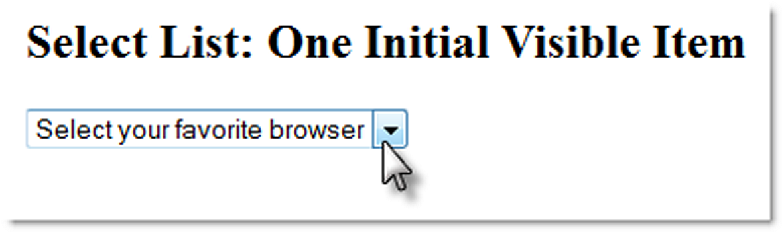
Select List (2 of 2)
Attributes:
name
id
size
multiple
Figure 9.11 A select list with size set to 1 functions as a drop-down box when the arrow is clicked

Slide 26
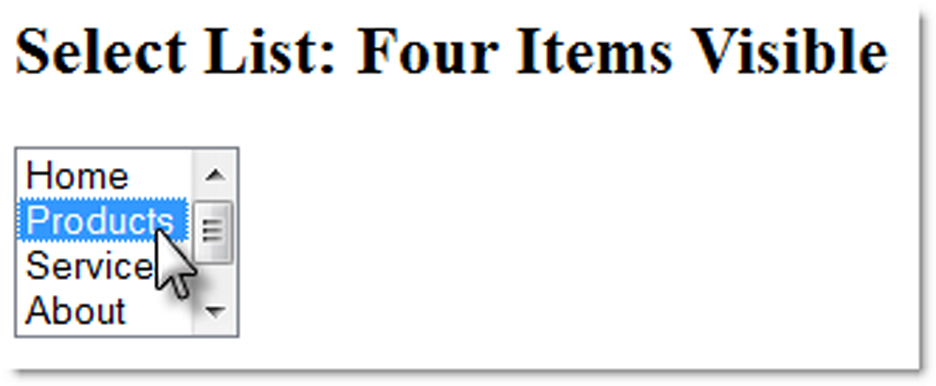
Options in a Select List
<option></option>
Configures the options in a Select List
Attributes:
value
selected
Figure 9.12 Because there are more than four choices, the browser displays a scroll bar

Slide 27
Checkpoint (1 of 4)
You are designing a web site for a client who sells items in a retail store.
They want to create a customer list for e-mail marketing purposes. Your client sells to consumers and needs a form that accepts their customer’s name and e-mail address.
Would you recommend using two input boxes (one for the name and one for the e-mail) or three input boxes (for the first name, last name, and email address)? Explain your answer.

Slide 28
Checkpoint (2 of 4)
You are designing a survey form for a client. One of the questions has 10 possible responses. Only one response can be selected per question.
What type of form control would you use to configure this question on the web page?
True or False. In a radio button group, the value attribute is used by the browser to process the radio buttons as a group.

Slide 29
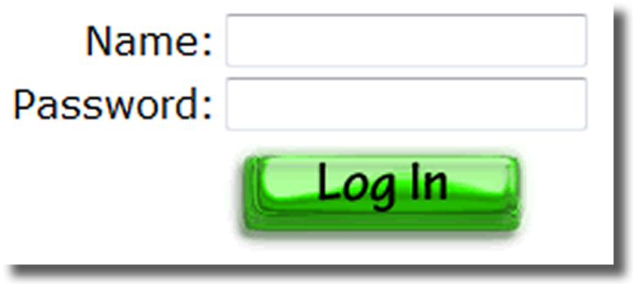
input Image Button
<input>
Submits the form
When clicked:
Triggers the action method on the form tag
Sends the form data (the name=value pair for each form element) to the web server.
Attributes:
type="image"
name
id
src
Figure 9.13 The web page visitor will select the image button to submit the form

Slide 30
Button Element (1 of 2)
<button></button>
A container tag
When clicked, its function depends on the value of the type attribute.
Can contain a combination of text, images, and media

Slide 31
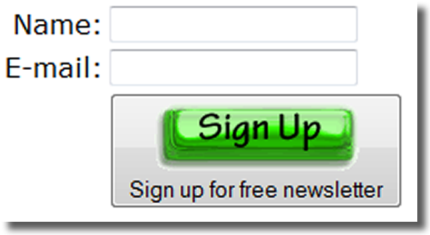
Button Element (2 of 2)
Attributes:
type="submit", type="reset", type="button"
name
id
alt
value
Figure 9.14 The button element configured as a submit button

Slide 32
Accessibility & Forms
Label Element
Fieldset Element
Legend Element
Tabindex Attribute
Accesskey Attribute

Slide 33
Label Element
<label></label>
Associates a text label with a form control
Two Different Formats: <label>Email: <input type="text" name=“email" id ="email"></label>
Or <label for="email">Email: </label> <input type="text" name="CustEmail" id= "email">

Slide 34
Fieldset and Legend Elements (1 of 3)
The Fieldset Element
Container tag
Creates a visual group of form elements on a web page
The Legend Element
Container tag
Creates a text label within the fieldset

Slide 35
Fieldset and Legend Elements (2 of 3)
<fieldset><legend>Customer Information</legend>
<label>Name: <input type="text" name="Name" id="Name“></label> <br><br>
<label>Email: <input type="text" name="Email" id="Email"></label>
</fieldset>

Slide 36
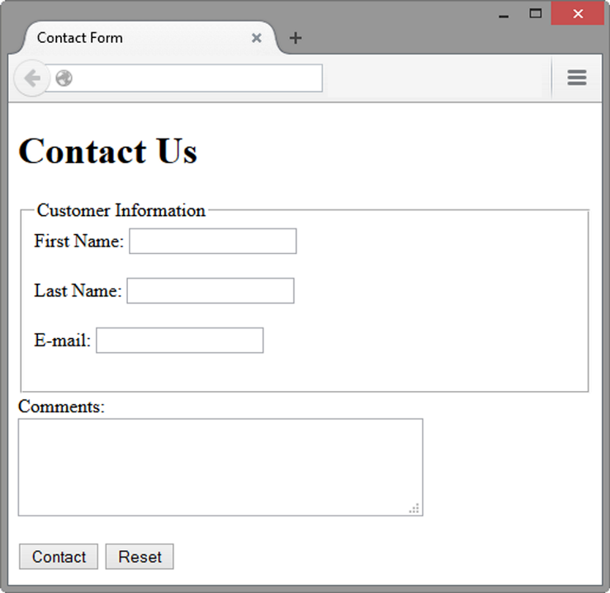
Fieldset and Legend Elements (3 of 3)
Figure 9.16 The fieldset, legend, and label elements

Slide 37
tabindex attribute
Attribute that can be used on form controls and anchor tags
Modifies the default tab order
Assign a numeric value
<input type="text" name="CustEmail" id="CustEmail" tabindex="1">

Slide 38
accesskey Attribute
Attribute that can be used on form controls and anchor tags
Create a “hot-key” combination to place the focus on the component
Assign a value of a keyboard letter
On Windows use the CTRL and the “hot-key” to move the cursor
<input type="text" name="CustEmail" id="CustEmail" accesskey="E">

Slide 39
Checkpoint (3 of 4)
Describe the purpose of the fieldset and legend elements.
Describe the purpose of the accesskey attribute and how it supports accessibility.
When designing a form, should you use the standard submit button, an image button, or a button tag? Are these different in the way that they provide for accessibility? Explain your answer.

Slide 40
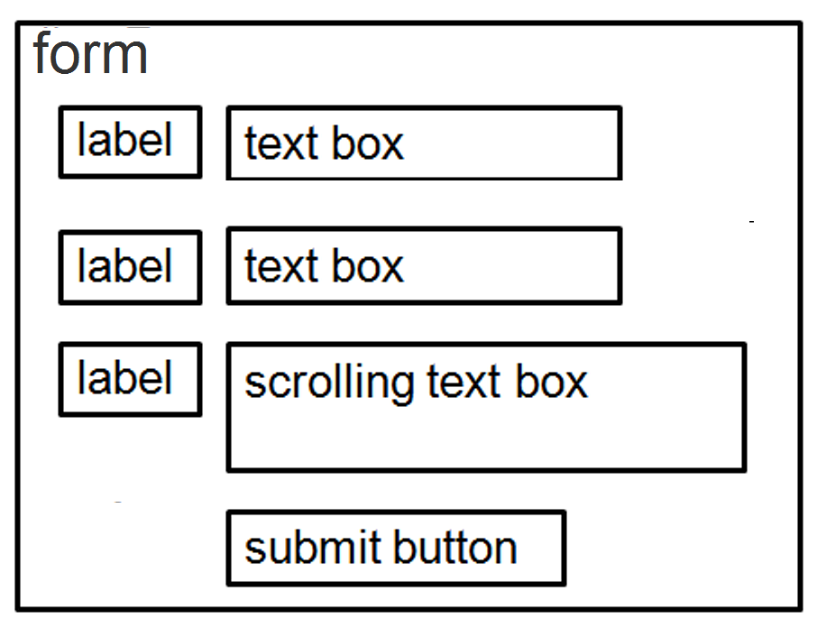
Using CSS Float to Style a Form (1 of 2)
form { background-color: #EAEAEA;
font-family: Arial, sans-serif;
width: 350px; padding: 10px;}
label { float: left; clear: left;
display: block; width: 100px;
Figure 9.18 Wireframe for a form

Slide 41
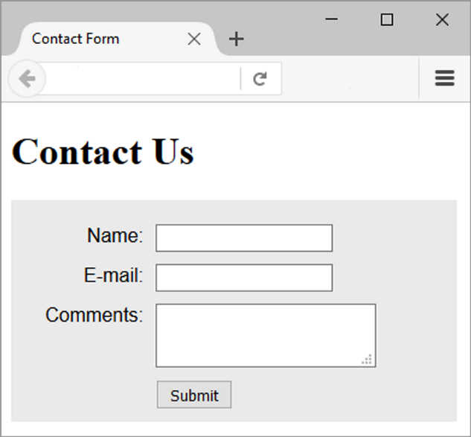
Using CSS Float to Style a Form (2 of 2)
text-align: right;
padding-right: 10px;
margin-top: 10px; }
input, textarea { margin-top: 10px;
display: block;}
input[type="submit"] { margin-left: 110px; }
Figure 9.19 This form is configured with
CSS

Slide 42
Using CSS Grid Layout to Style a Form (1 of 3)
form { display: grid;
grid-template-rows: auto;
grid-template-columns: 6em 1fr;
grid-gap: 1em; gap: 1em;
background-color: #EAEAEA;
font-family: Arial, sans-serif;
min-width: 25em;

Slide 43
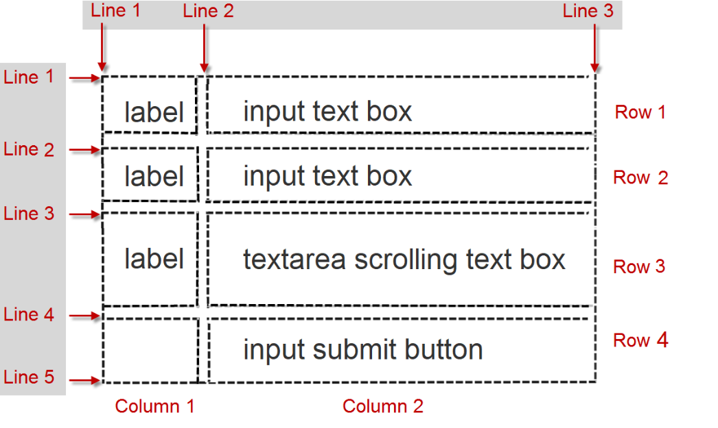
Using CSS Grid Layout to Style a Form (2 of 3)
Figure 9.20 The grid for the form

Slide 44
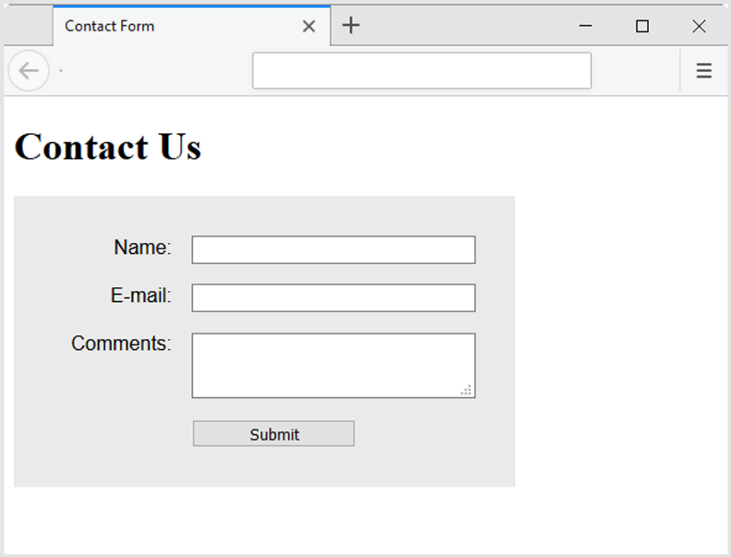
Using CSS Grid Layout to Style a Form (3 of 3)
width: 60%;
padding: 2em; }
input[type="submit"] {
grid-column: 2 / 3;
width: 10em; }
Figure 9.21 The form is styled with CSS grid layout

Slide 45
Server-Side Processing
Your web browser requests web pages and their related files from a web server.
The web server locates the files and sends them to your web browser.
The web browser then renders the returned files and displays the requested web pages for you to use.

Slide 46

CGI Common Gateway Interface
A protocol for a web server to pass a web page user's request to an application program and accept information to send to the user.
Figure 1.5 Web client and web server

Slide 47
Server-Side Scripting
One of many technologies in which a server-side script is embedded within a Web page document saved with a file extension such as:
.php (PHP)
.cfm (Adobe ColdFusion)
.jsp (Sun JavaServer Pages)
.aspx (ASP.Net).
Uses direct execution — the script is run either by the web server itself or by an extension module to the web server.

Slide 48
Steps in Utilizing Server-Side Processing
Web page invokes server-side processing by a form or hyperlink.
Web server executes a server-side script.
Server-side script accesses requested database, file, or process.
Web server returns web page with requested information or confirmation of action.

Slide 49
Common Uses of Server-Side Scripting
Search a database
Place an order at an online store
Send a web page to a friend
Subscribe to a newsletter

Slide 50

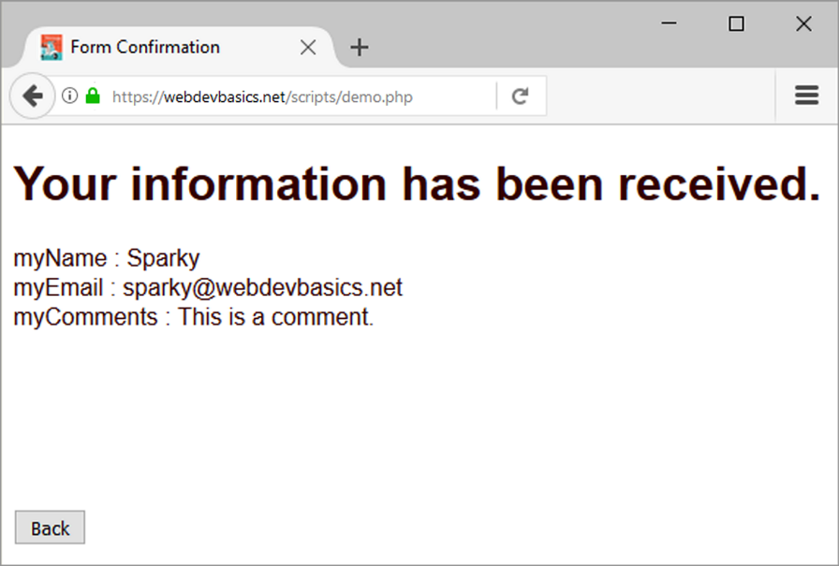
Sending information to a Server-side Script
<form method="post" action="https://webdevbasics.net/scripts/demo.php ">
Figure 9.21 The form is styled with CSS grid layout
Figure 9.22 The server-side script has created this web page in response to the form

Slide 51
Sources of Free Server-Side Processing
Many web host providers offer free scripts for their clients. Contact their support area or FAQ to learn more about their services.
Some web sites that offer FREE remotely hosted scripts (in return for displaying an ad).
http://formbuddy.com
http://www.formmail.com
https://formspree.io

Slide 52
Server-Side Scripting Technologies
JavaServer Pages http://www.oracle.com/technetwork/java/javaee/jsp
ColdFusion http://www.adobe.com/products/coldfusion
PHP http://www.php.net
Ruby on Rails http://www.rubyonrails.org
Microsoft’s .NET Framework http://www.microsoft.com/net

Slide 53
Checkpoint (4 of 4)
Describe server-side processing.
Describe why communication is needed between the developer of a server-side script and the web page designer.

Slide 54
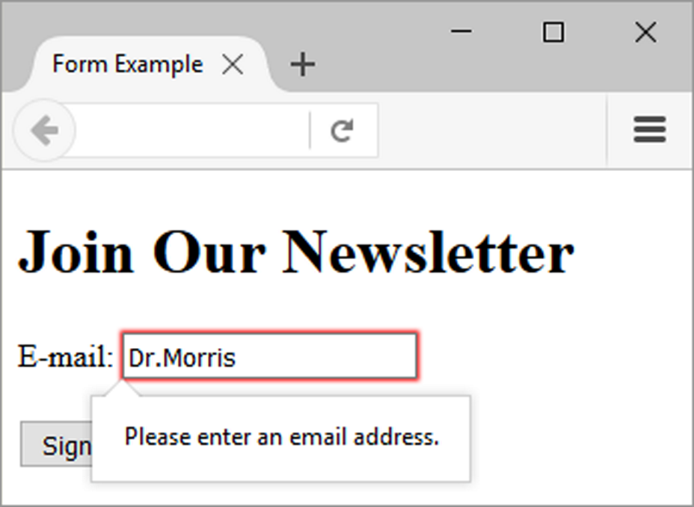
HTML5: Email Text Box
<input>
Accepts text information in e-mail address format
Common Attributes:
type="emai"
name
id
size
maxlength
value
placeholder
required
Figure 9.23 The browser displays an error
message

Slide 55
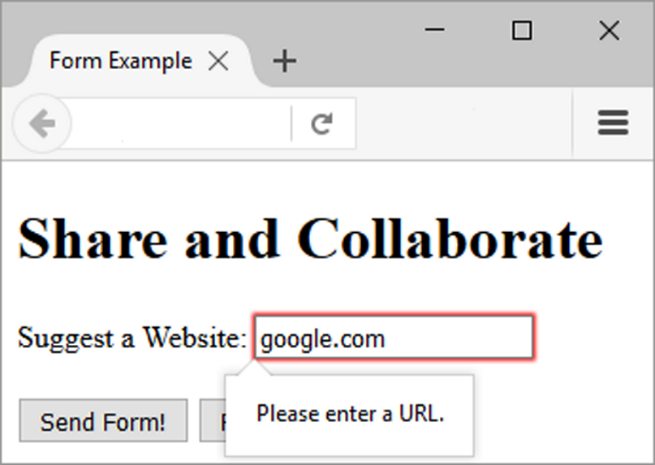
HTML5: Telephone Number Text Box
<input>
Accepts text information in telephone number format
Common Attributes:
type="tel"
name
id
size
maxlength
value
placeholder
required
Figure 9.24 The browser displays an error
message

Slide 56
HTML5: Search Text Box
<input>
Accepts search terms
Common Attributes:
type="search"
name
id
size
maxlength
value
placeholder
required

Slide 57
HTML5: Datalist Control (1 of 2)
<label for="color">Favorite Color:</label> <input type="text" name="color" id="color" list="colors">
<datalist id="colors">
<option value="red" label="Red">
<option value="green" label="Green">
<option value="blue" label="Blue">
<option value="yellow" label=“Yellow">
<option value="pink" label="Pink">
<option value="black" label="Black">
</datalist>

Slide 58
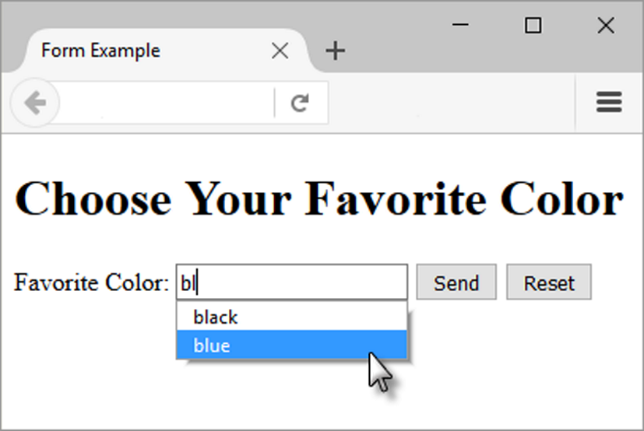
HTML5: Datalist Control (2 of 2)
Figure 9.25 Firefox displays the datalist form control

Slide 59
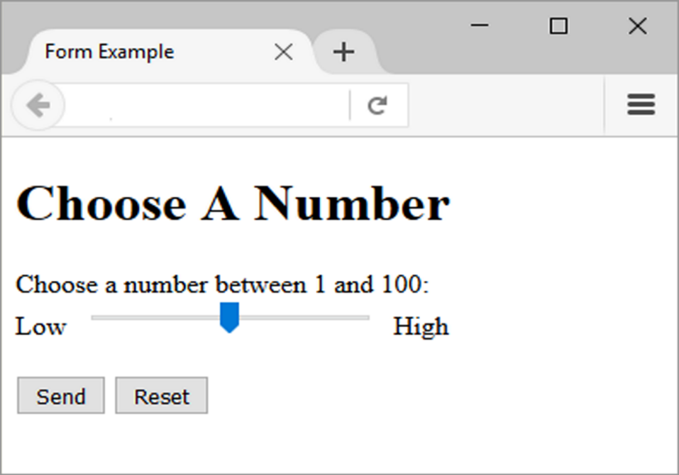
HTML5: Slider Control
<label for="myChoice">
Choose a number between 1 and 100:</label><br>
Low <input type="range" name="myChoice" id="myChoice" min="1" max="100"> High
Figure 9.27 The Firefox browser displays the
range form control.

Slide 60
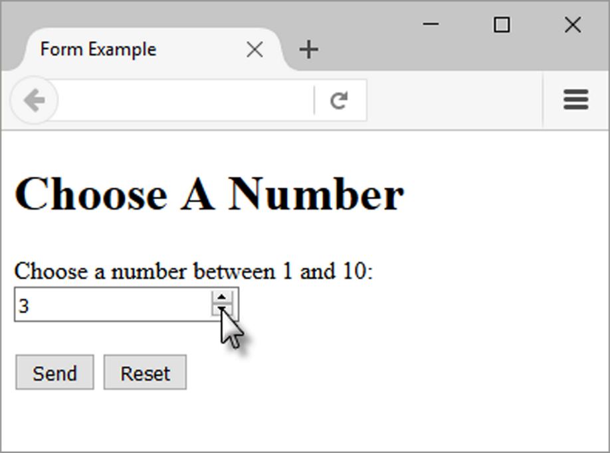
HTML5: Spinner Control
<label for="myChoice">Choose a number between 1 and 10:</label> <input type="number" name="myChoice" id="myChoice“ min="1" max="10">
Figure 9.28 A spinner control displayed in the Firefox browser

Slide 61
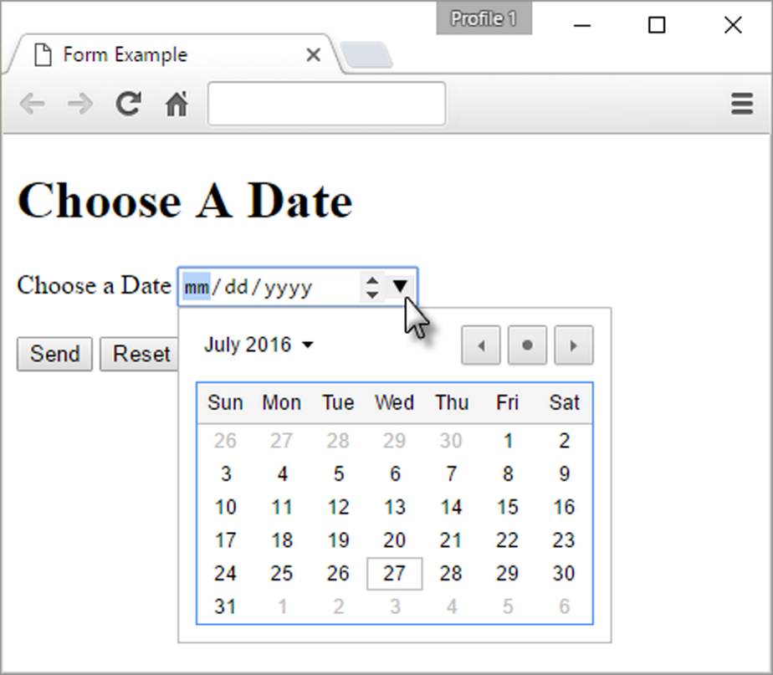
HTML5: Calendar Date-Picker Control
<label for="myDate">Choose a Date</label> <input type="date" name="myDate" id="myDate">
Figure 9.29 A date form control displayed in the Firefox browser

Slide 62
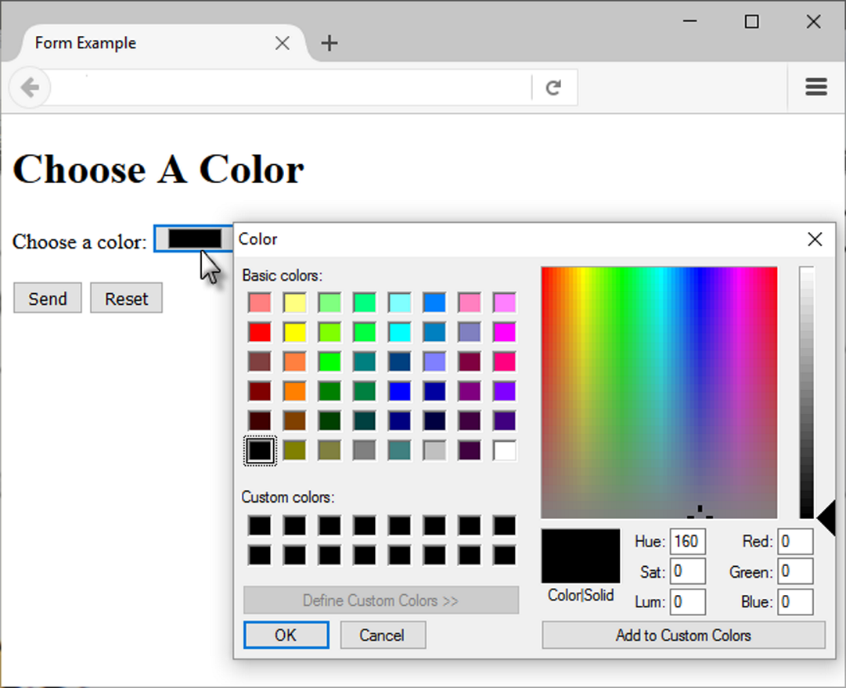
HTML5: Color Well Control
<label for="myColor">Choose a color:</label> <input type="color" name="myColor" id="myColor">
Figure 9.30 The Firefox browser supports the color-well form control

Slide 63
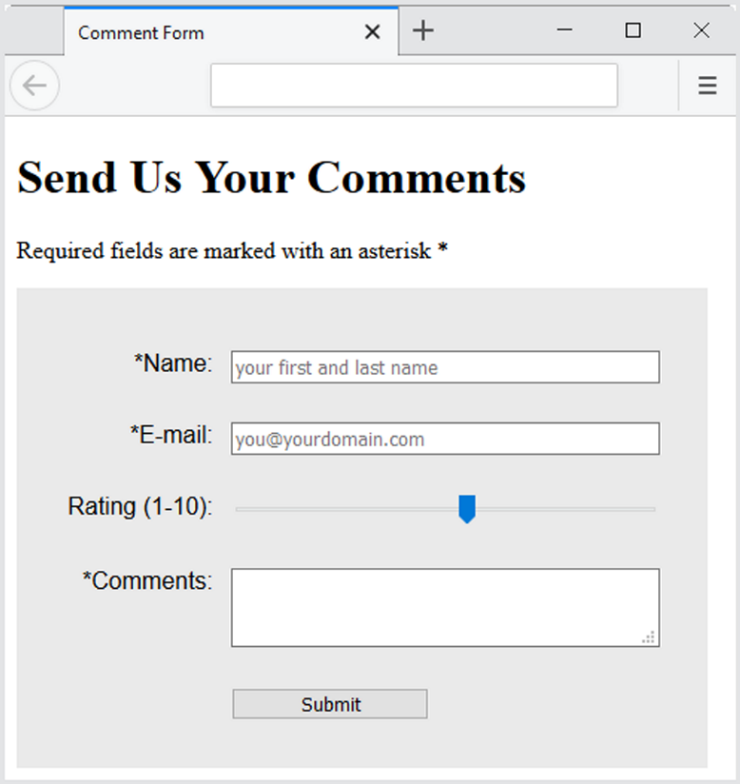
Practice with an HTML5 Form
The form display and functioning varies with browser support.
Figure 9.31 The form displayed in the Firefox browser

Slide 64
Summary
This chapter introduced the use of forms on web pages.
You learned about how to configure form elements and provide for accessibility.
You also learned how to configure a form to access server-side processing.
In addition, you learned about new HTML5 form controls.

